Slide 1
Project of EQ2341 Pattern Recognition and Machine Learning, Human Activity Recognition
Ziyue Yang Boyue Jiang
ziyuey@kth.se boyue@kth.se

Slide 2
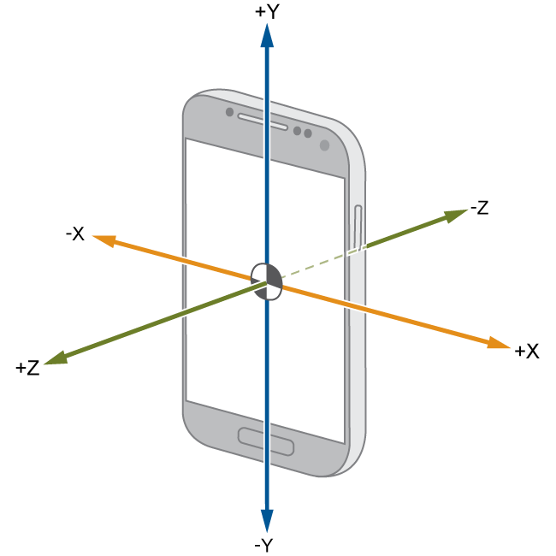
Task Description
Using 3-axis accelerometer inside a smart phone, record the accelerations of three different activities (standing, walking and running) over time.
Train a machine learning model that can tell whether a given observed accelerometer data sequence comes from standing, walking or running.

Slide 3
Methodology
Regard the accelerometer measurement sequence as the output of a Hidden Markov Source. The source has 3 hidden states (i=1,2,3), each state corresponds to a type of human activity.
Model the emission distributions of the 3 hidden states as Gaussian distributions.
Train the Hidden Markov Model with (pre-processed) training data and Expectation-Maximization algorithm. The trained HMM can predict the hidden state sequence of given test data.
Validate the performance of the trained HMM on test data that is independent of training

Slide 4
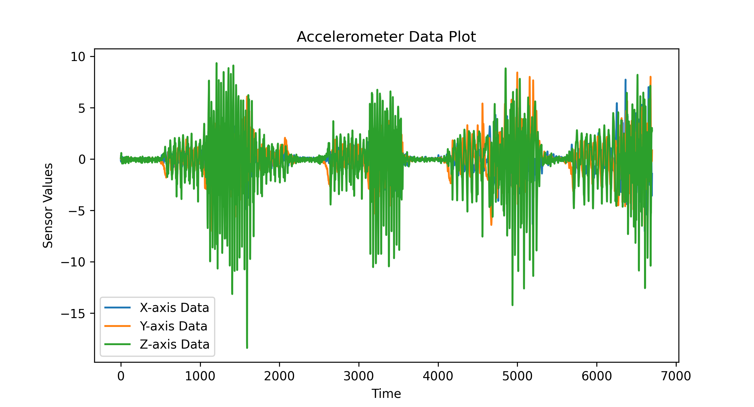
Data Collection

Slide 5
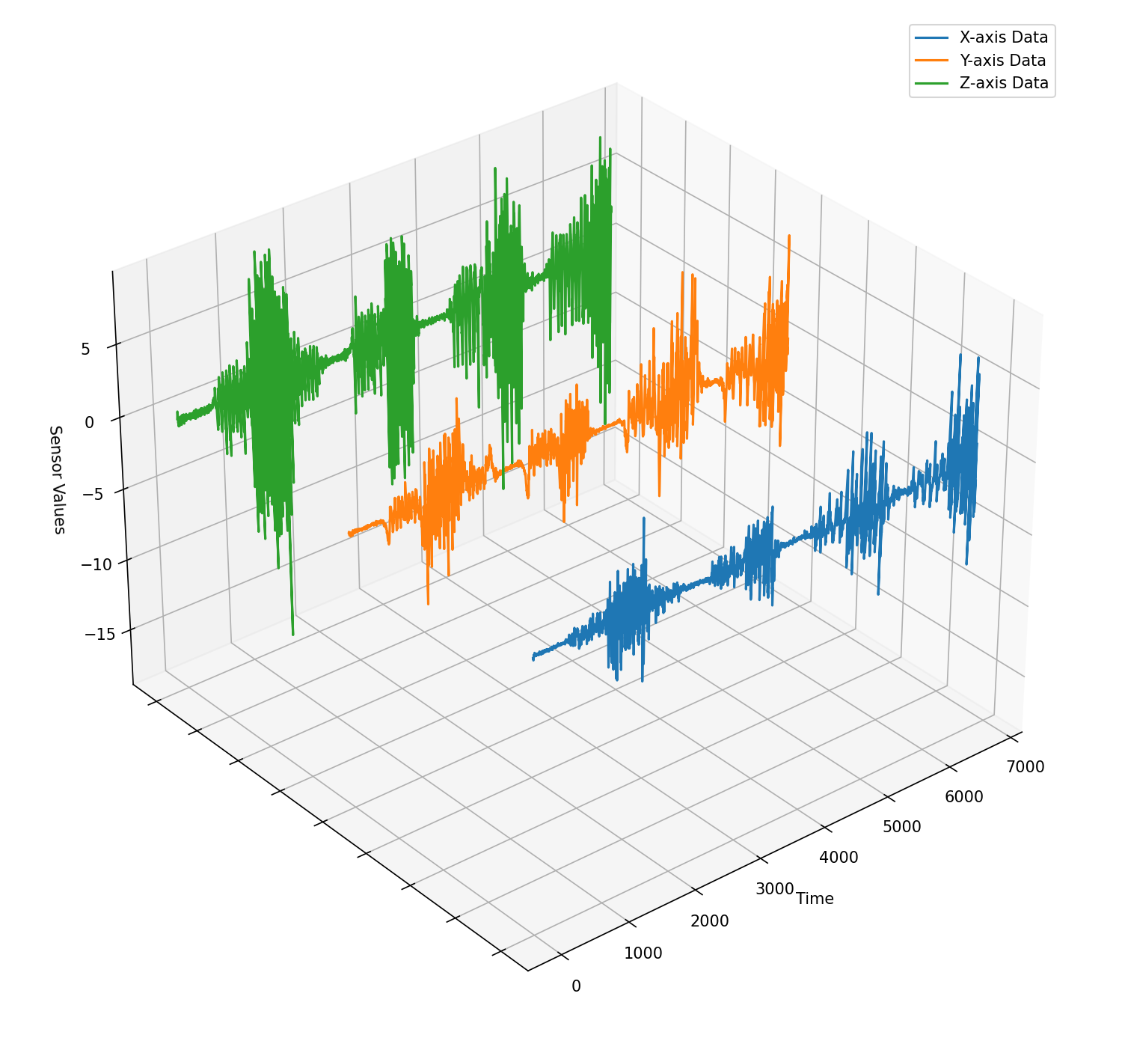
Data Collection
Training data are recorded outdoors, test data are recorded inside gym.
When recording, the phone is parallel to the ground and points to the direction of human movement.
For training data: Shape (3, 6699), in a single .csv file.

Slide 6
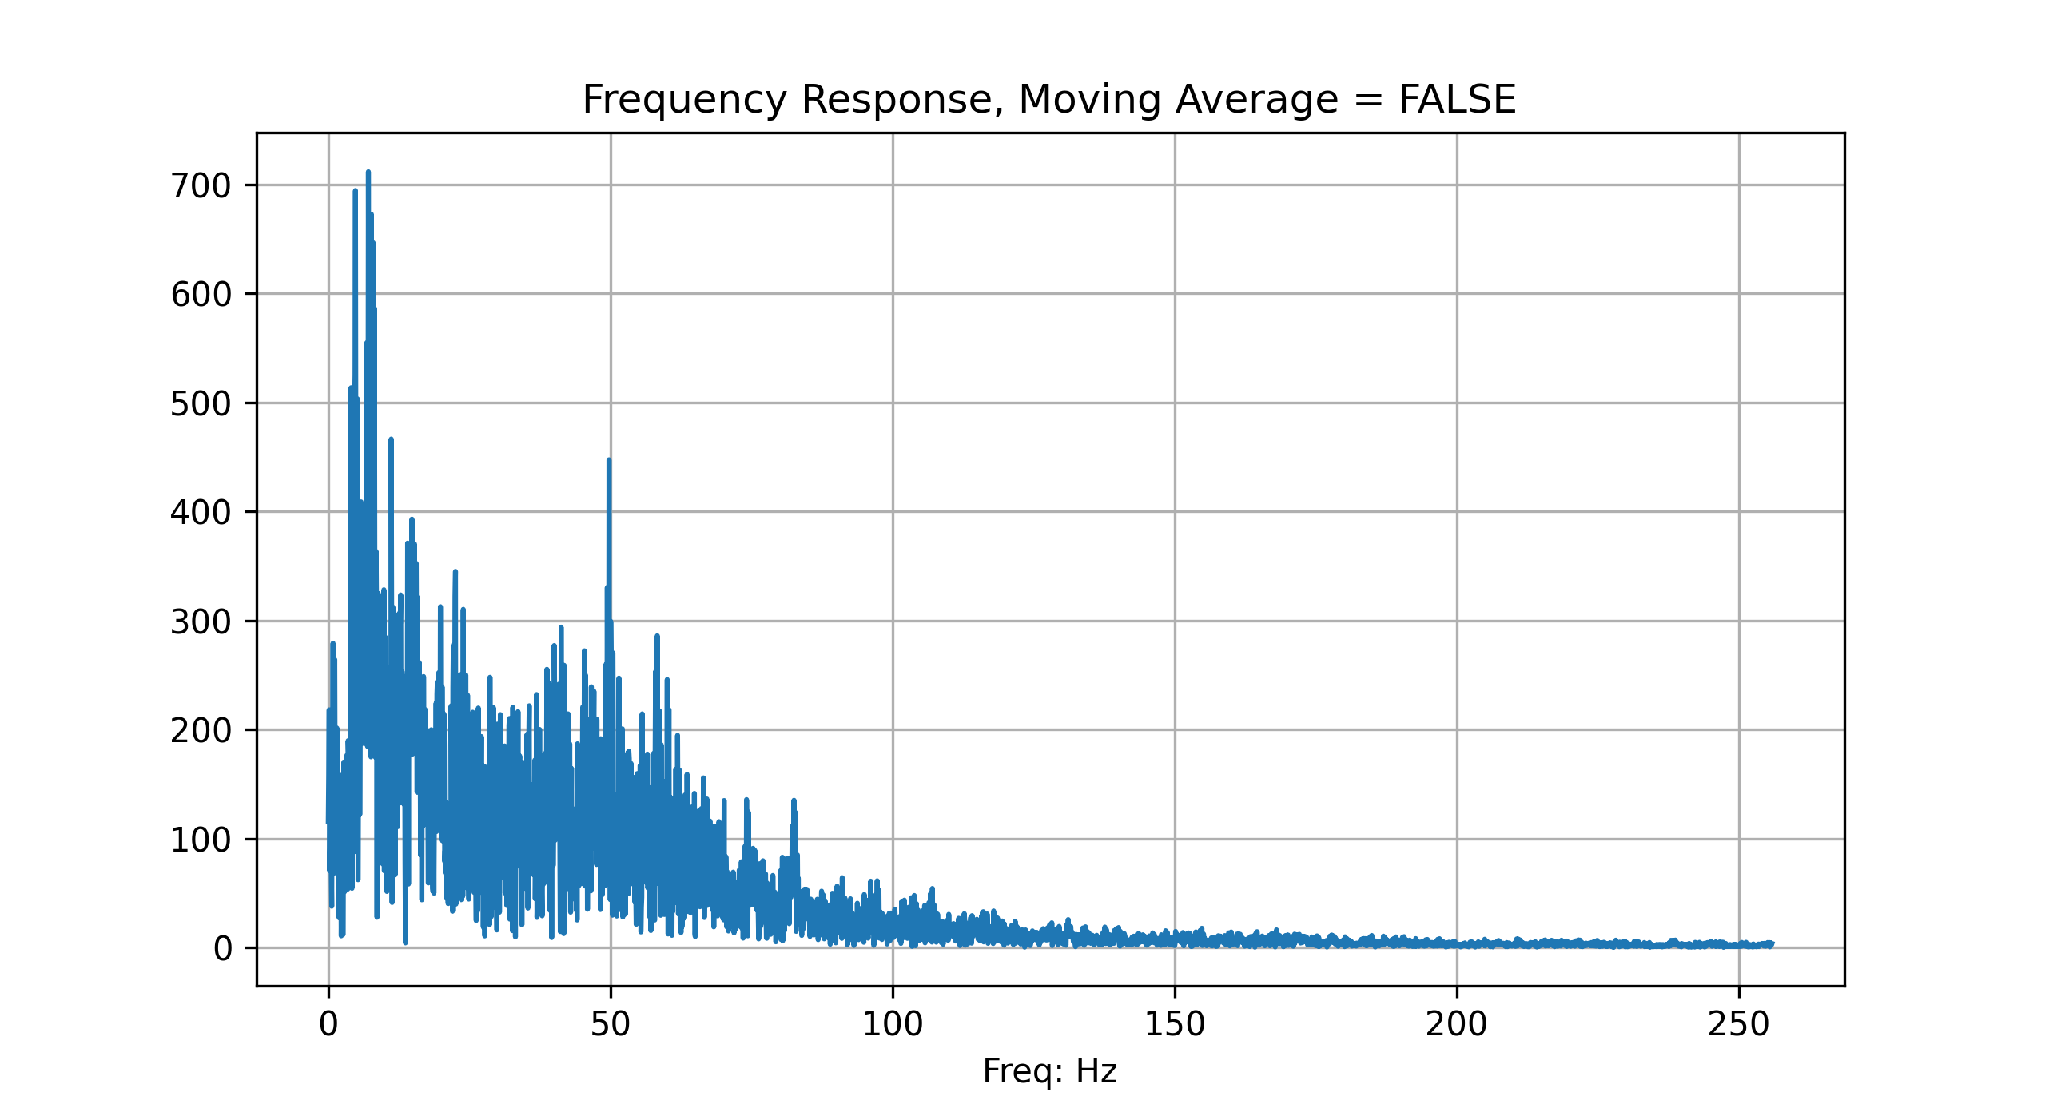
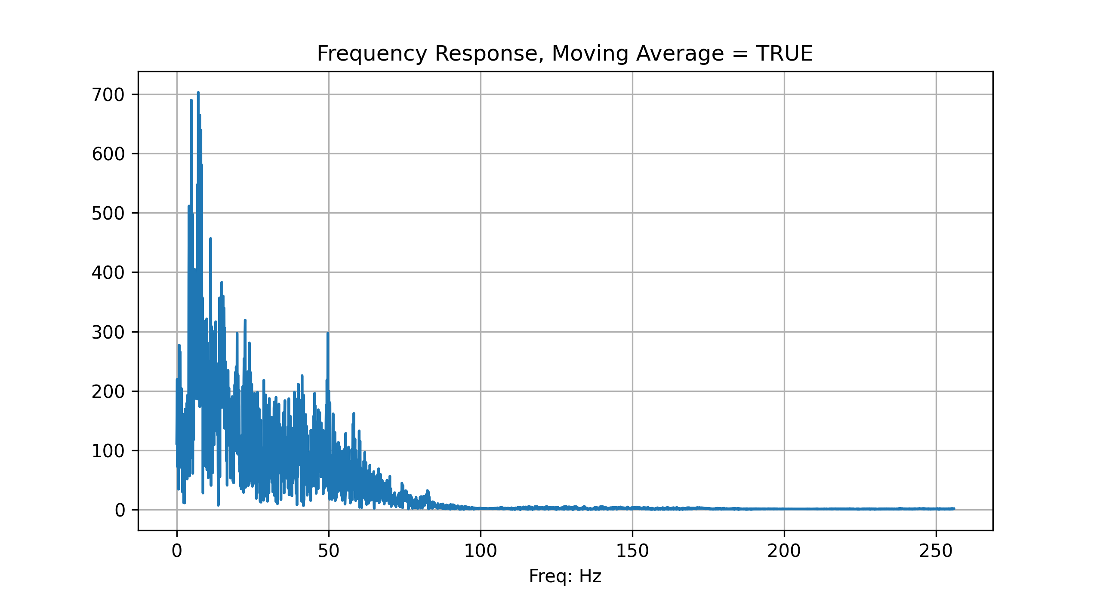
Data Pre-processing
Moving Average, window_size=5, to remove high frequency noises.

Slide 7
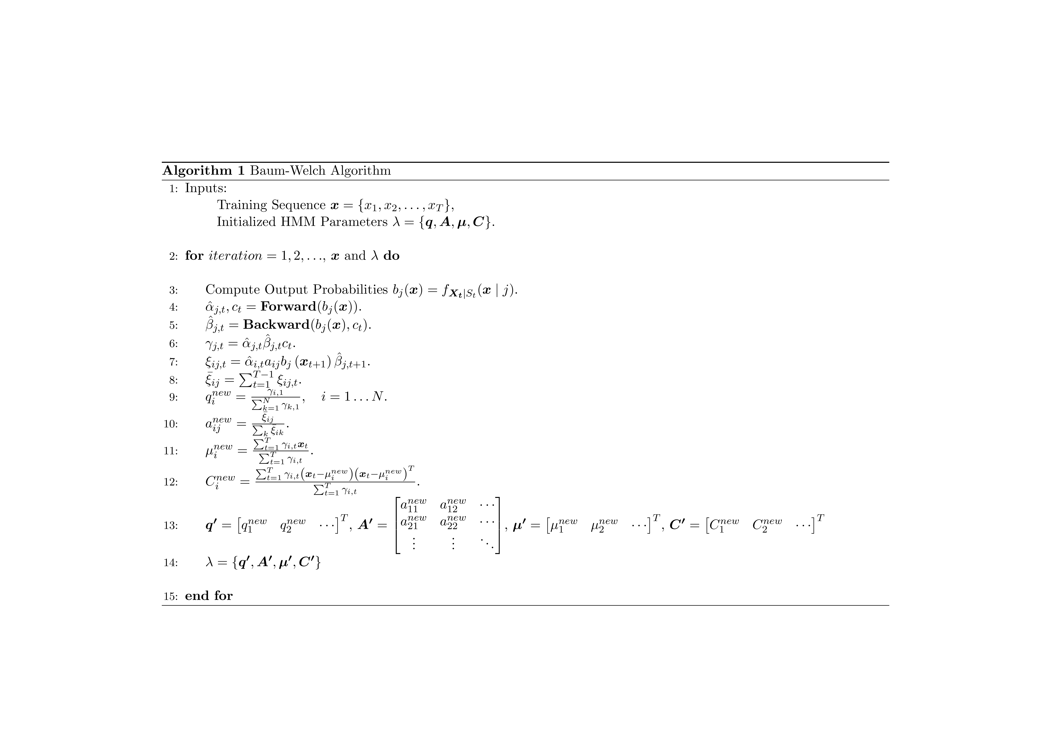
Train HMM

Slide 8
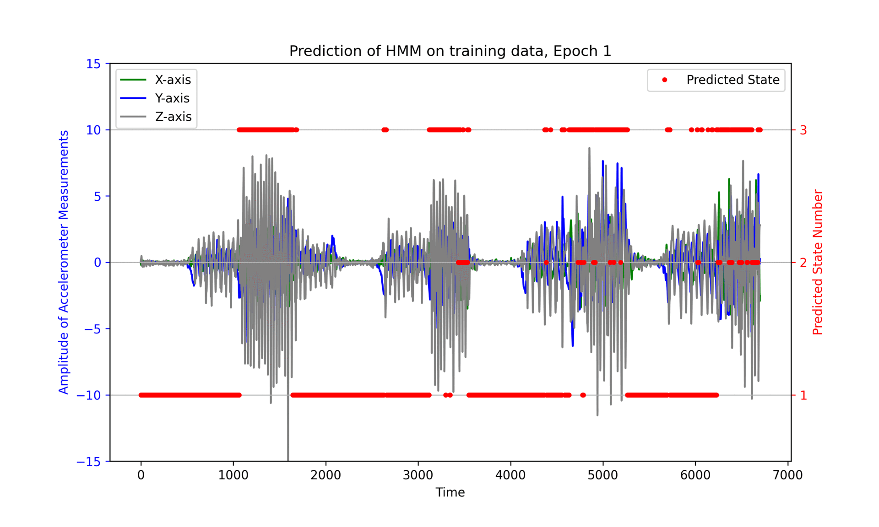
Train HMM
We train our HMM using only a single training sequence.
After training, the mappings are:
State 1 ⬄ Standing
State 2 ⬄ Walking
State 3 ⬄ Running

Slide 9
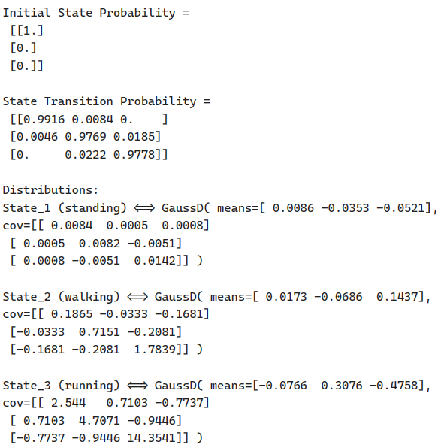
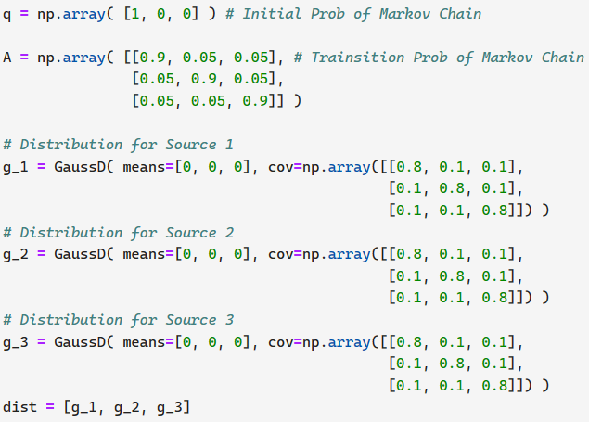
Train HMM
Parameter Initialization:
Trained Parameters (Epoch=30):

Slide 10
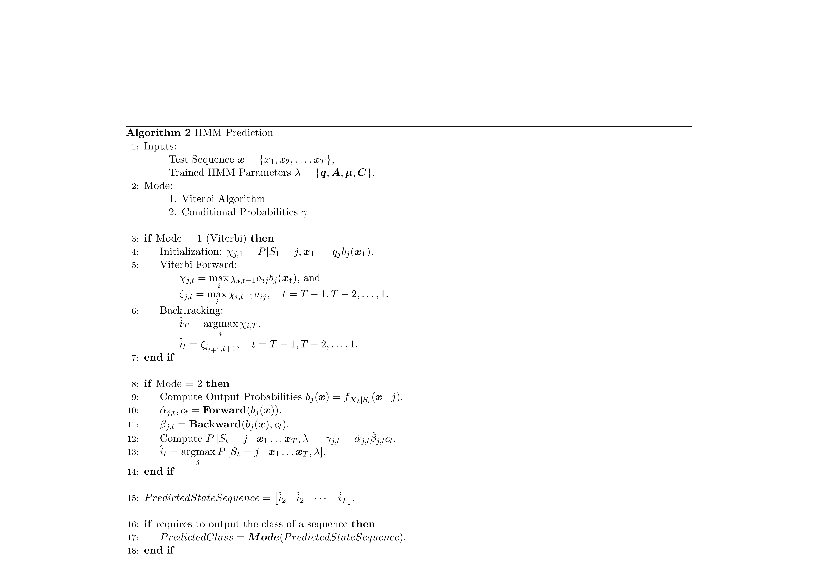
Prediction using HMM

Slide 11
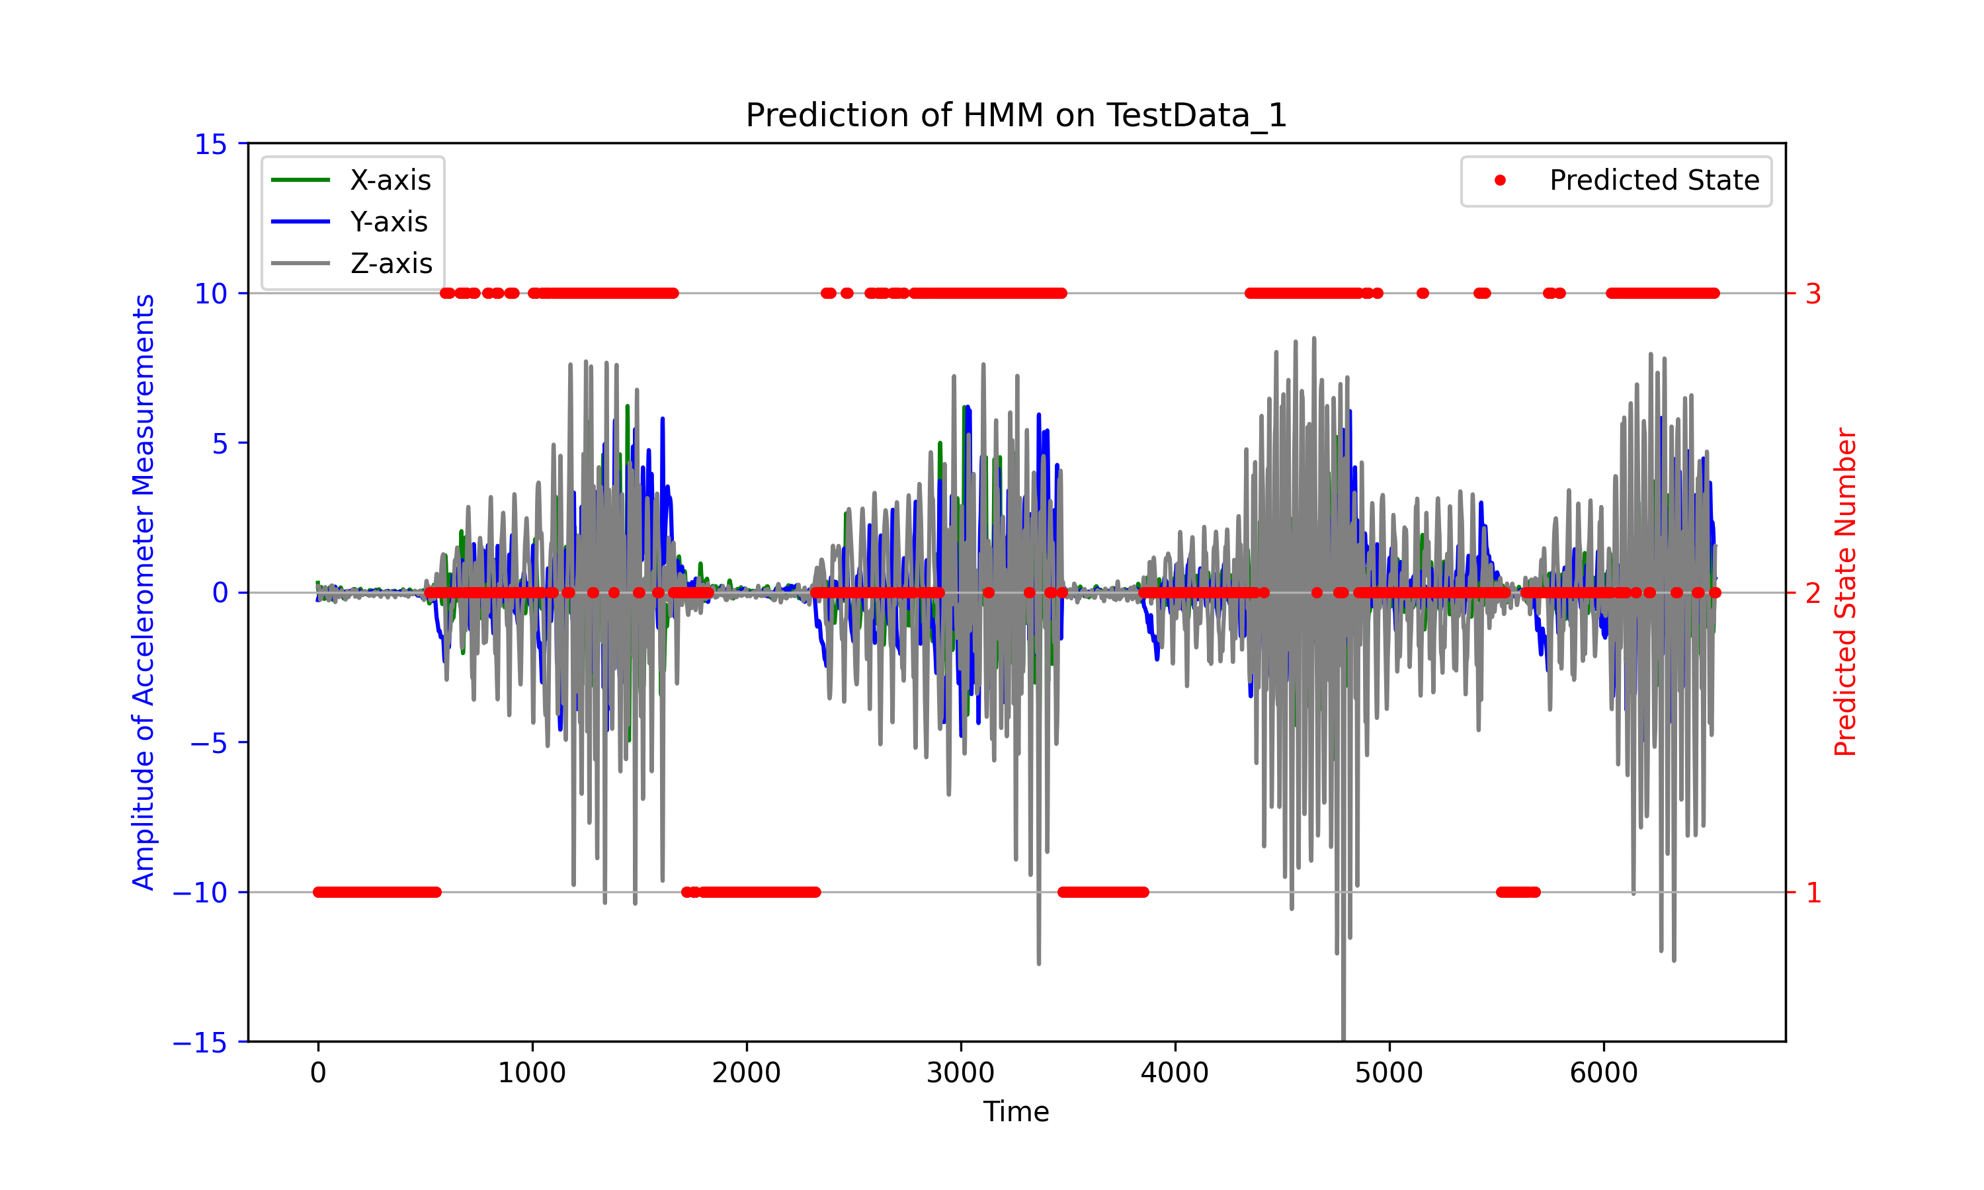
Predict the State Sequence of Test Data

Slide 12
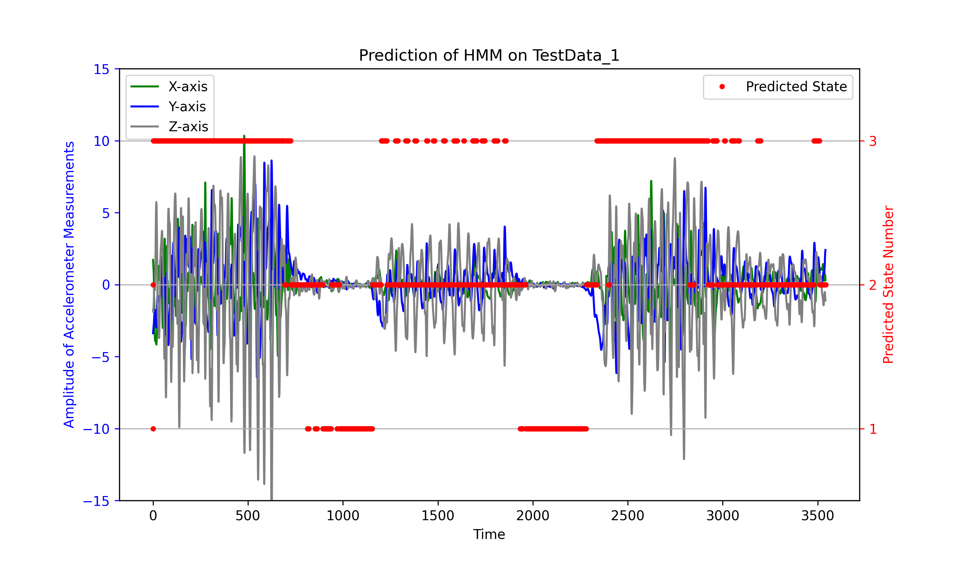
Predict the State Sequence of Test Data

Slide 13
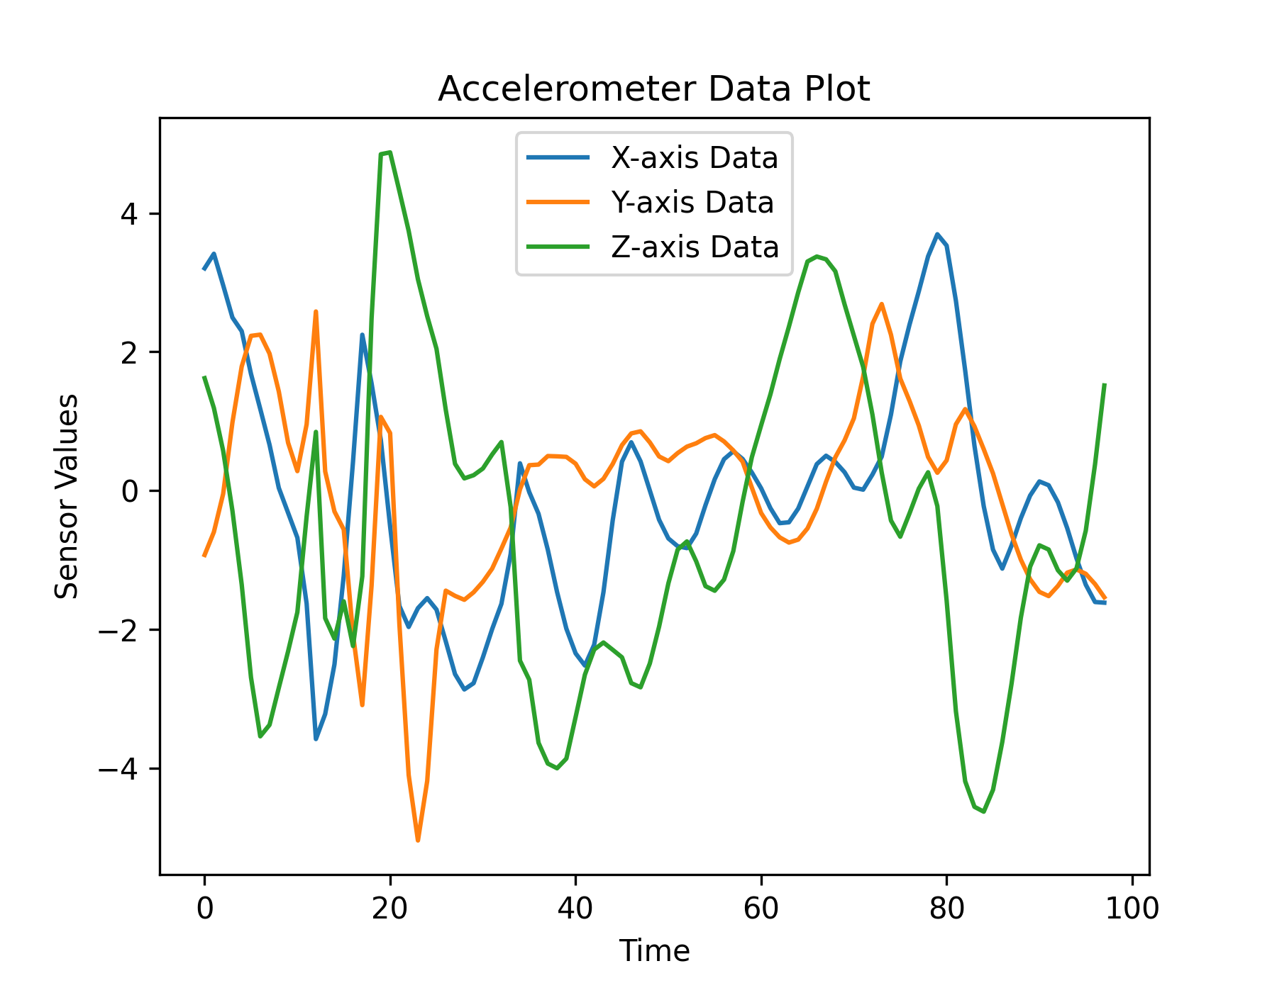
Classification Performance
We record three additional test data, during which the recorder stays in the same activity for a long time period.
These data are randomly clipped into small pieces of various lengths, and labeled.
Approximately 321 samples per class.

Slide 14
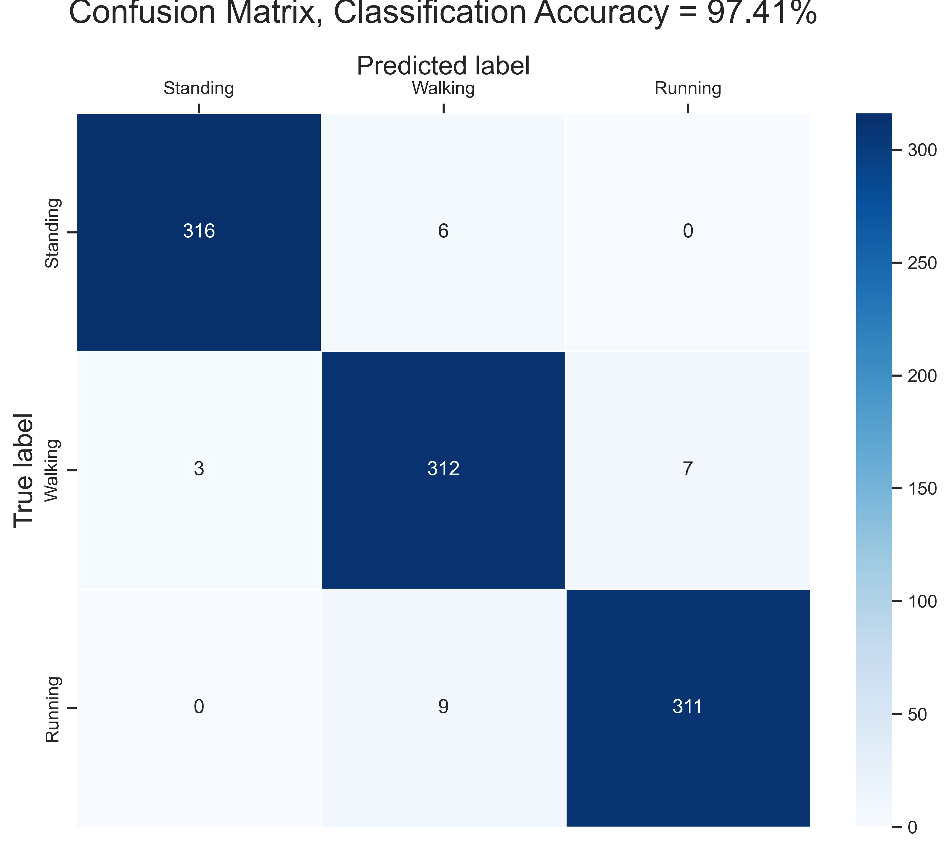
Classification Performance

Slide 15
Analysis
What is good:
Very simple model (48 trainable params), fast training with not bad performance.
Only use a single training sequence, which is time-saving. Also, this implies the model has high generalization ability.
Since only use a single training sequence, we have much prior knowledge about our training data, then it is easier to “control” how the model behaves. E.g., the mapping pairs between state number and activity.
What is not good, or can be improved:
Training data involves 5 out of 6 possible state changes, missing 1 [standing→running]. This might result in some of transition probabilities in A approaches to 0 after training.
Only use a single train sequence will always (in the author’s opinion) have the problem that the probability of one of the initial state converges to 1 with other two equals to 0, after training, i.e., [1 0 0], [0 1 0] or [0 0 1].
The ill-conditioned q and A might cause some problems.

Slide 16
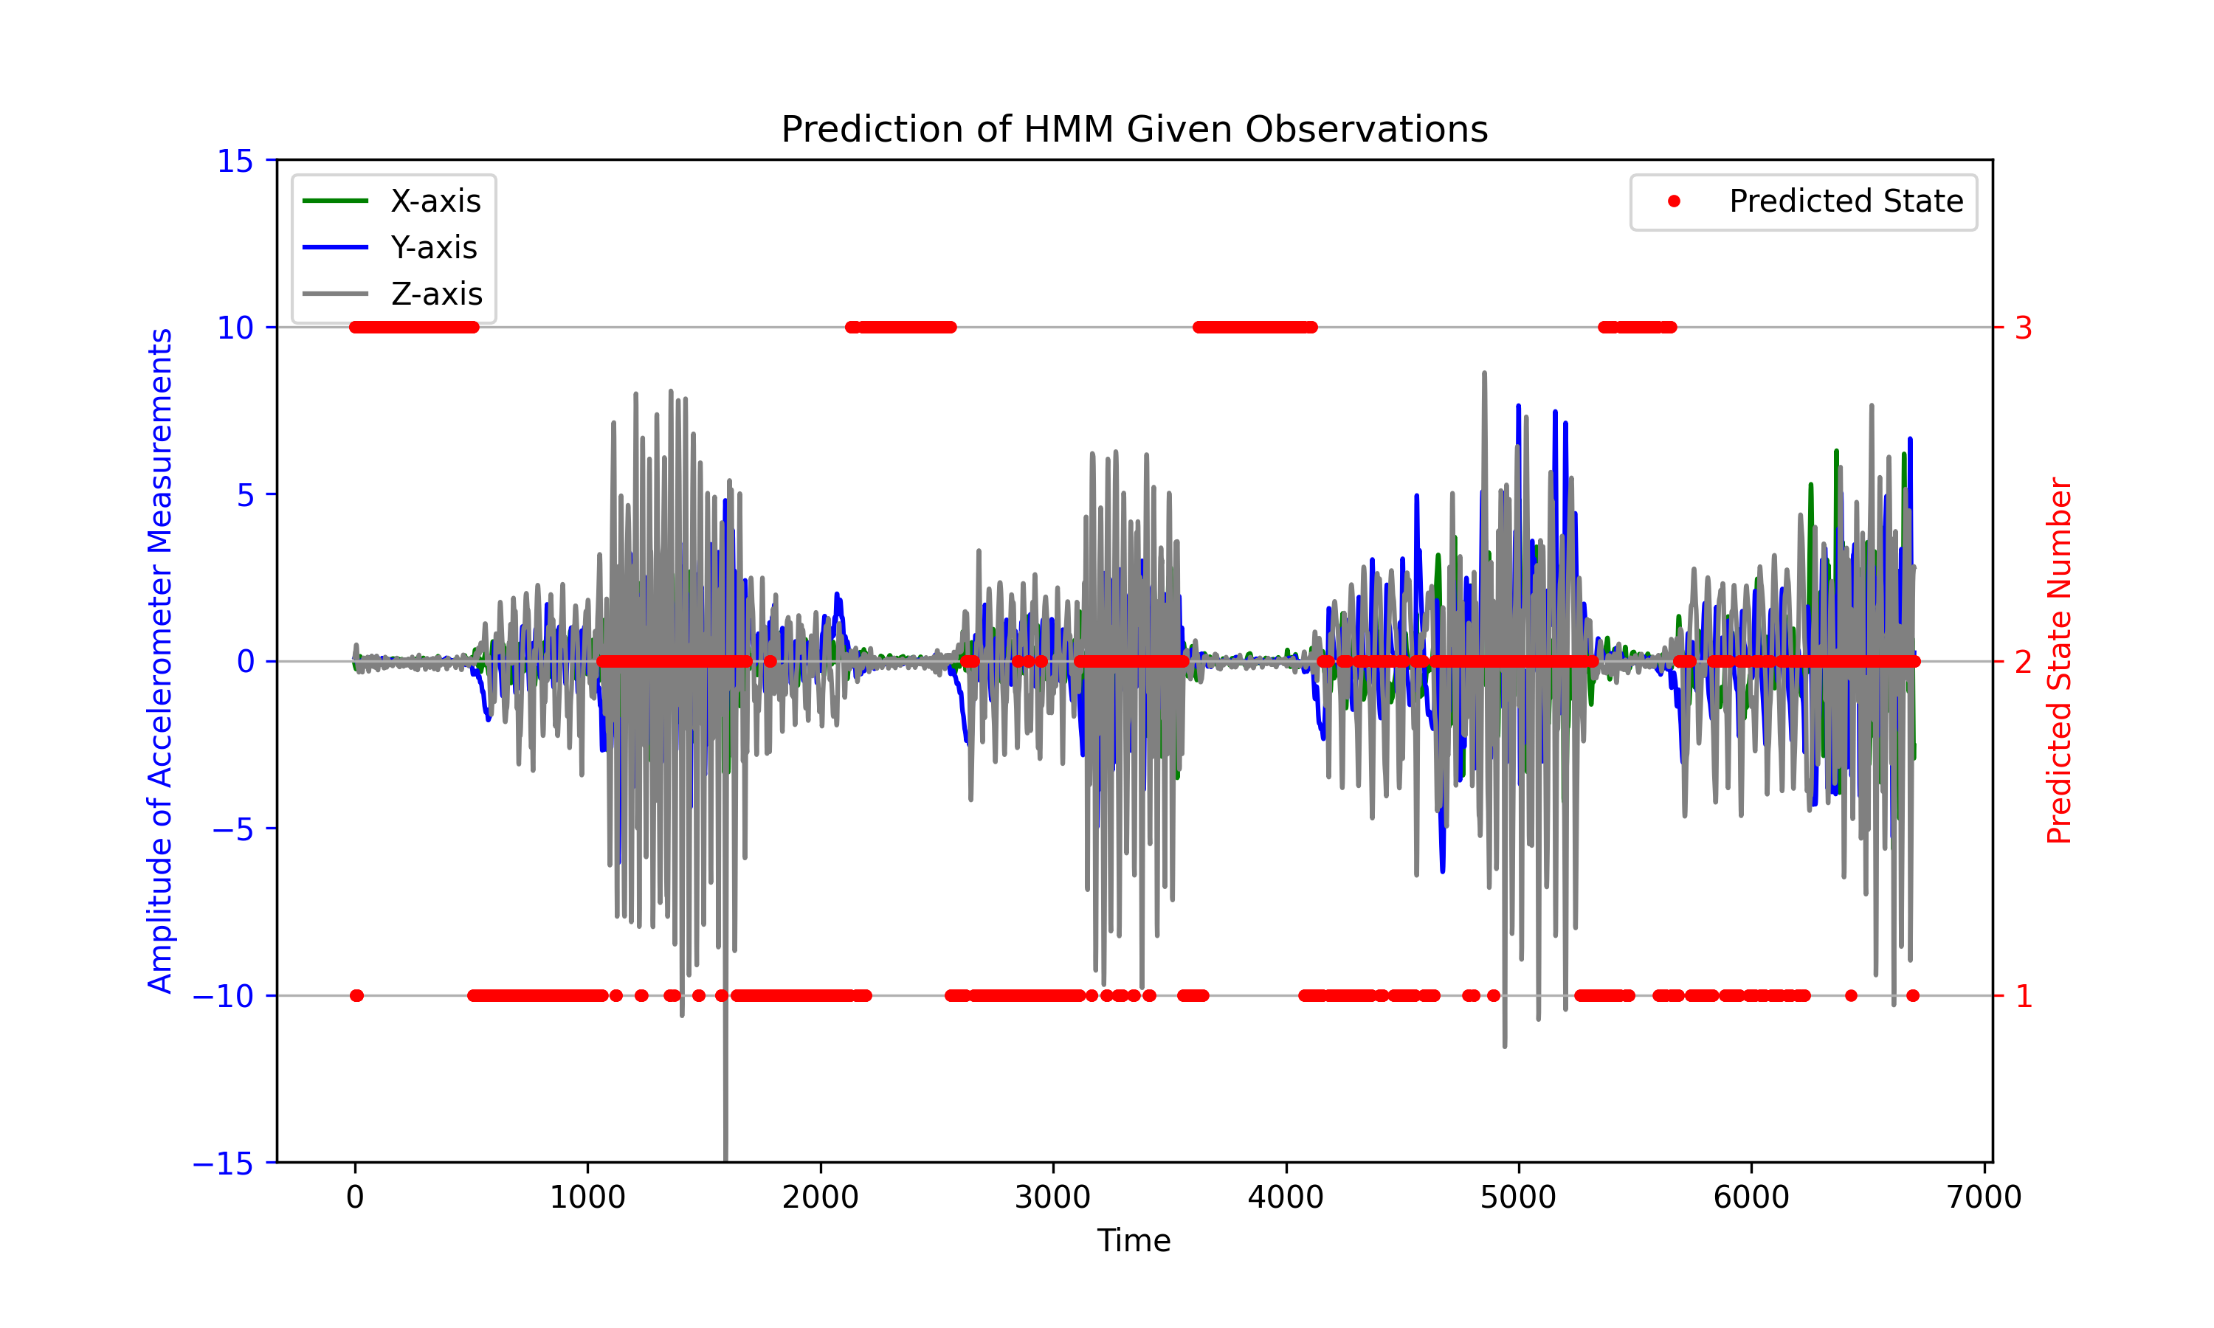
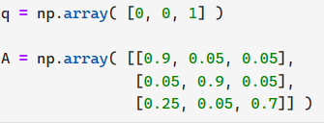
Analysis
Training data starts with “Standing”, then “Walking”. If I want the trained HMM to have the following mappings:
Standing ⬄ State 3
Walking ⬄ State 1
Running ⬄ State 2
I could initialize the params as:

Slide 17
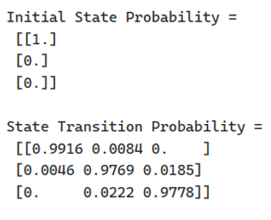
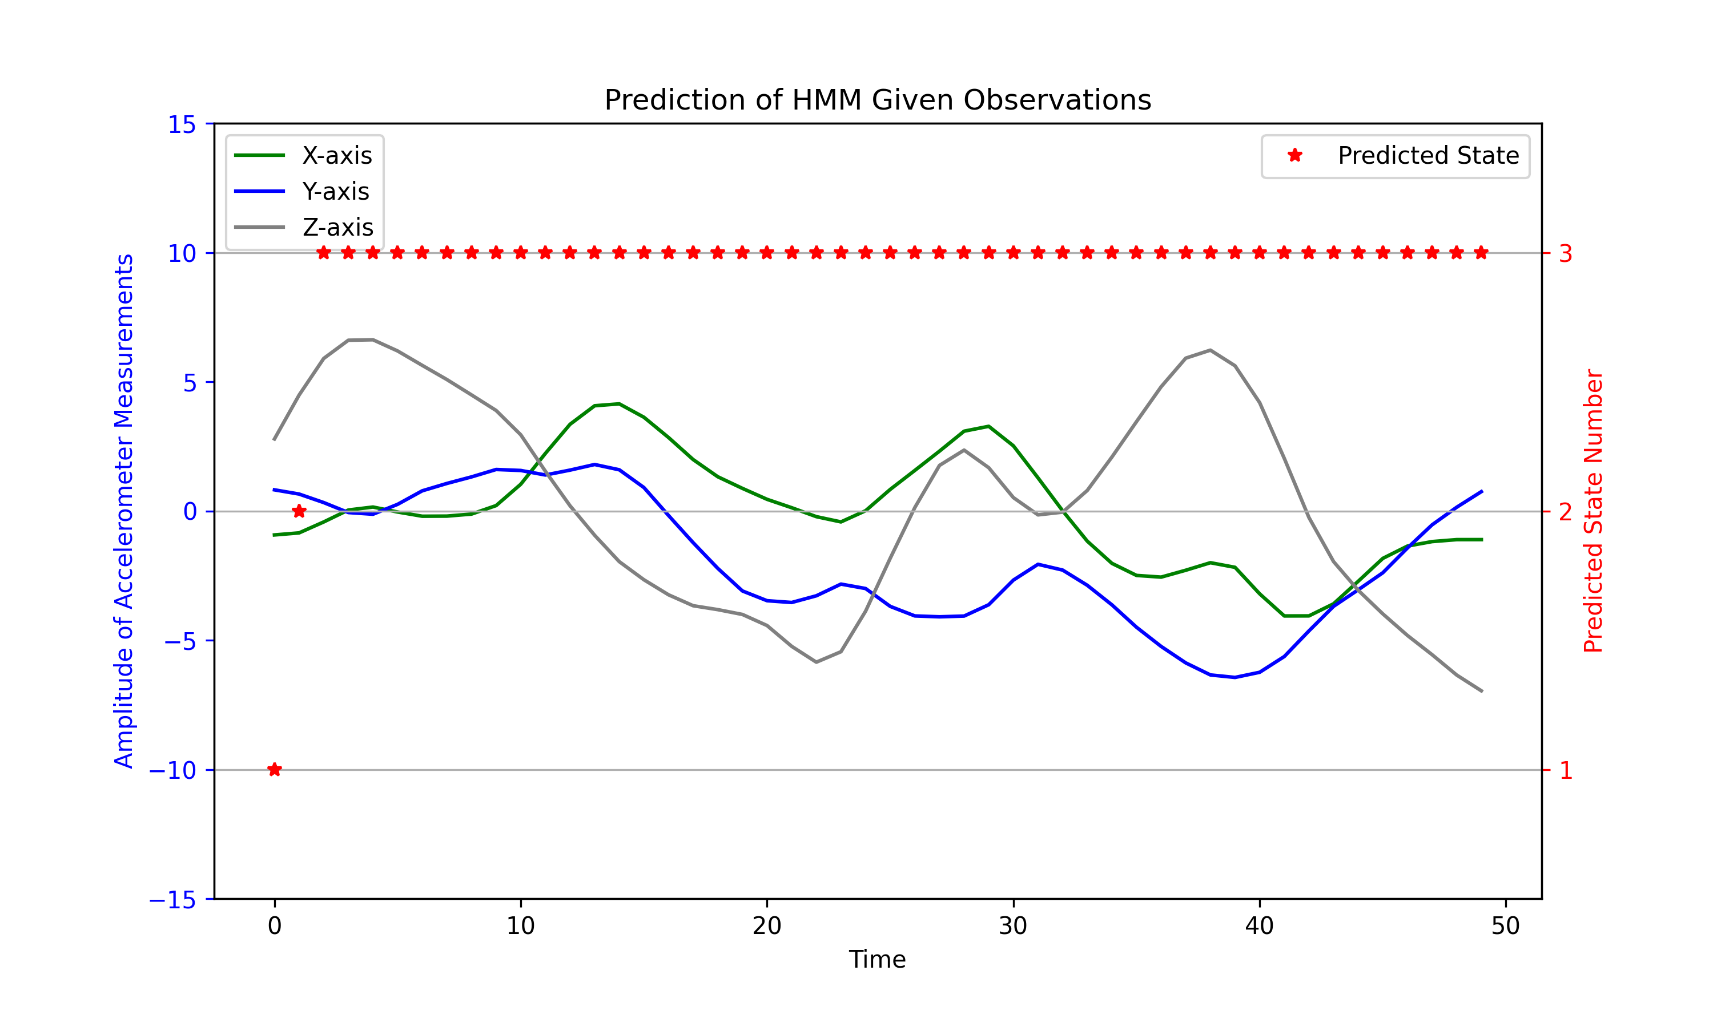
Analysis
Use trained HMM to predict the hidden states of a “Running” Sample. As you can see, the first two predicted states at the very start is not state 3, due to the ill-conditioned parameters.

